Slide 1
Fruit Classification using Convolutional Neural Network via Adjust Parameter and Data Enhancement
Group:9
Presenter: [ LiShengQi Jiang] [ZhongHang Zheng]
Date:2024/5/14

Slide 2
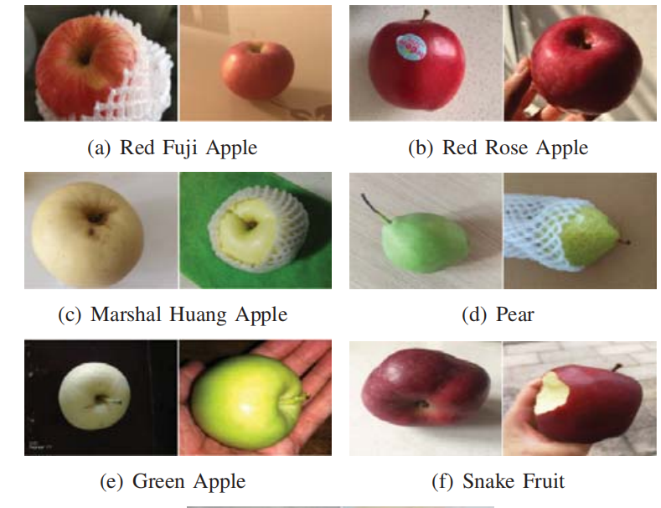
Motivation and Main Problem
Main problem
The problem addressed in the paper is the automatic and accurate classification of fruits using convolutional neural networks (CNNs). This task is challenging due to the high visual similarity between different fruit varieties, such as certain types of apples, pears, and peaches.

Slide 3
Motivation and Main Problem
Motivation
Fruit industry has become the third major industry after grain and vegetable.
Accurate fruit classification can greatly benefit fruit sellers by improving the efficiency of sorting and categorizing fruits, ultimately enhancing market operations and reducing manual labor.

Slide 4
Motivation and Main Problem
Challenge
Visual Similarity: Some fruit varieties look very similar, making it difficult to distinguish them using traditional image processing methods.
Complex Backgrounds: Real-world images often have complex backgrounds that can interfere with the accuracy of classification algorithms.
Data Diversity: Limited and varied data sets can hinder the performance of machine learning models, requiring effective data augmentation techniques to enhance the dataset.

Slide 5
Motivation and Main Problem
Key Insights of the Proposed Work:
· Convolutional Neural Networks (CNNs): The use of CNNs for automatic feature extraction and classification, which outperforms traditional methods in terms of accuracy.
· Parameter Adjustment: Fine-tuning the parameters of the CNN to improve classification performance.
· Data Enhancement: Implementing data enhancement techniques to increase the diversity and size of the dataset, leading to improved model accuracy, particularly on self-made datasets with complex backgrounds.

Slide 6
Problem Setting
To develop a method for automatic recognition and classification of fruits using convolutional neural networks (CNNs). Developing robust techniques for handling complex backgrounds and visually similar fruit varieties through advanced data enhancement and parameter tuning.
The goal is to achieve high classification accuracy for both public and self-made datasets.

Slide 7
Related Work
Zhang extracted wavelet entropy (WE) from fruit images and classified them based on the optimized method of biogeography, with a total accuracy of 89.47%
from： S. Wang, Y. Zhang, G. Ji, J. Yang, J. Wu, and L. Wei, “Fruit classification by wavelet-entropy and feedforward neural network trained by fitness scaled chaotic ABC and biogeography-based optimization,” Entropy, vol. 17, no. 8, pp. 5711-5728, 2015.
Calculated quantitative information such as RGB color distribution, CIE1931 standard tristimulus values, chromaticity coordinates, and mean values for guava fruit, then estimated the ripeness level through an artificial neural network (ANN).
A. Kanade and A. Shaligram, “Development of machine vision based system for classification of Guava fruits on the basis of CIE1931 chromaticity coordinates,” 2015 2nd International Symposium on Physics and Technology of Sensors (ISPTS). IEEE, pp. 177-180, 2015.
Used K-Means clustering to segment passion fruit and then classified the ripeness level of passion fruits through an artificial neural network(ANN), with a total accuracy of 90%.
S. W. Sidehabi, A. Suyuti, I. S. Areni, and I. Nurtanio, “Classification on passion fruit’s ripeness using K-means clustering and artificial neural network,” 2018 International Conference on Information and Communications Technology (ICOIACT). IEEE, pp. 304-309, 2018.

Slide 8
Limitations of Prior Work
Limited Feature Extraction Techniques:
Earlier studies, such as those by Zhang et al. (2015) and Kanade (2015), relied heavily on manually extracted features like wavelet entropy and color distribution metrics. These techniques, while useful, are not as powerful or flexible as the automatic feature extraction capabilities of deep learning models like CNNs.
Restricted Dataset Complexity:
2. Many previous works used datasets with relatively simple backgrounds. For instance, Lu et al. (2018) and Wang (2018) used datasets where the fruit images had uniform or less complex backgrounds, which does not reflect the challenges of real-world scenarios where the background can be quite varied and complex.

Slide 9
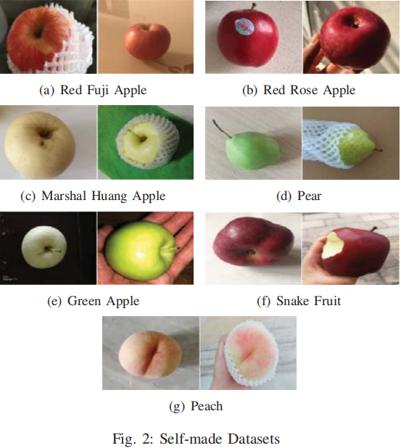
Experimental Preparation
Database
The public dataset is provided by halcon software have
758 copies in 5 categories with simple background.
The self-made dataset was collected by oneself, mainly from
the network and self-shooting with complex background and
other adverse conditions, totaling 11527 categories

Slide 10
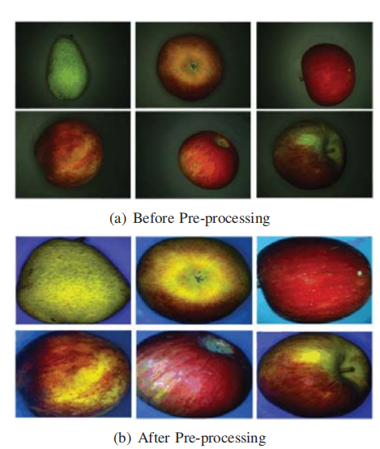
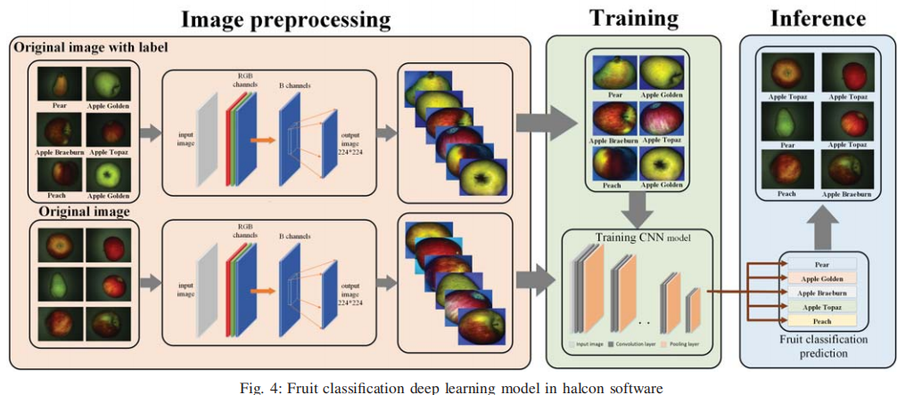
Experimental Preparation
Deep Learning
For the public dataset, it was placed in the blue color channel, and the accurate fruit image was obtained by global threshold retrieval and image cropping.
This experiment uses the training network built into halcon, because halcon
encapsulates the pre-training network and does not open the underlying source
code, so it does not give the specific framework structure of the convolutional
neural network.

Slide 11
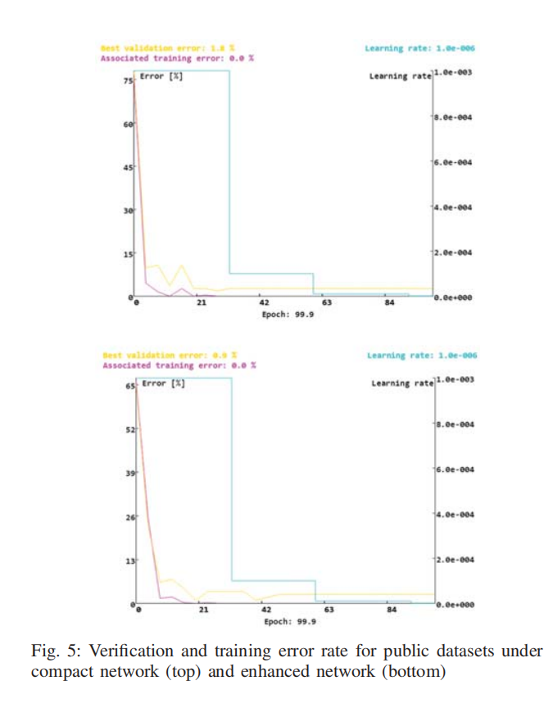
Experimental Setup& Result
1.Neural Network
Halcon software is configured with compact neural network and enhanced
neural network former high memory, high operation efficiency, the latter has more
convolution layers, so it can extract more features, data input to obtain the following
data images.
From the figure we can get that the best verification error rate of compact neural
network is 1.8%, and the best verification error of enhanced neural network is only
1.3%. As can be seen from the graph, the classification effect of the enhanced network is
slightly better than that of the compact network.
蓝线表示学习率，金线表示验证错误率，紫线表示训练错误率
Blue lines indicate the learning rate
Gold lines indicate the validation error rate
Purple lines indicate the training error rate

Slide 12
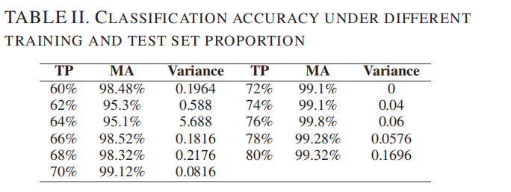
Experimental Setup& Result
2.Training Set Ratio

Slide 13
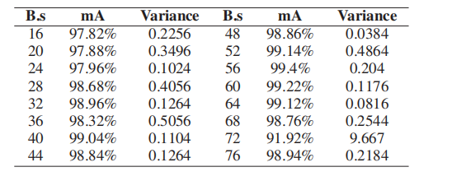
Experimental Setup& Result
3.Batchsize
Batchsize: The batch size, which is the number of training
samples taken in the training set per training.

Slide 14
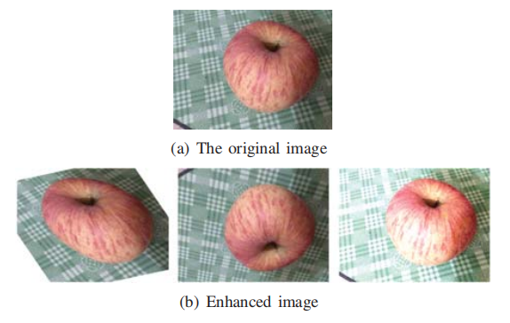
Experimental Setup& Result
4.Picture Processing

Slide 15
Experimental Setup& Result
4.Picture Processing
The classification network in the halcon software has a classification accuracy of 90.2% for the self-made data set. From the
images, theverification erro rate was redued from original 9.8% to 6.4% and 7% when enhancing the brightness of the image or
randomly cropping the image alone.But if we randomly flipping images verification error rate of this method reached 3.5% becaue
this method has a significantimprovement in the classification and recognition of self-made data sets.

Slide 16
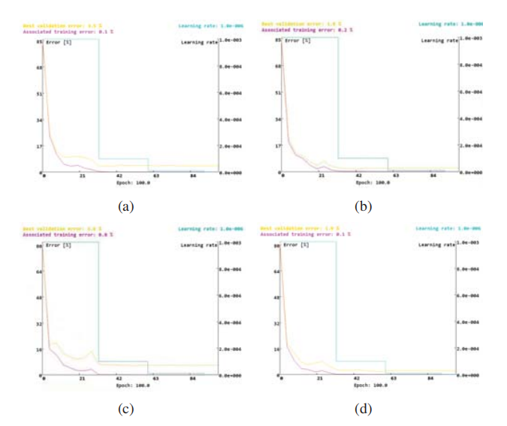
Experimental Setup& Result
4.Picture Processing
There is random random flipping> enhanced brightness> random cropping

Slide 17
Extended Readings
W. Astuti, S. Dewanto, K. E. N. Soebandrija, and S. Tan, “Automaticfruit classification using support vector machines: a comparison withartificial neural network,” IOP Conference Series: Earth and Environmental Science. IOP Publishing, vol. 195, no. 1, 2018.
S. W. Sidehabi, A. Suyuti, I. S. Areni, and I. Nurtanio, “Classificationon passion fruit’s ripeness using K-means clustering and artificialneural network,” 2018 International Conference on Information andCommunications Technology (ICOIACT). IEEE, 2018.
S. Lu, Z. Lu, S. Aok, and L. Graham, “Fruit Classification Based onSix Layer Convolutional Neural Network,” 2018 IEEE 23rd InternationalConference on Digital Signal Processing (DSP). IEEE, 2018

Slide 18
Summary
The following three conclusions are drawn in this paper:
Convolutional neural networks extract feature vectors from images mainly through self-learning, without using specific feature processing technology;
Appropriate training parameters can improve the classification accuracy of fruit images to a certain extent;
Appropriate data enhancement methods can improve the classification accuracy of fruit images by convolutional neural networks

Slide 19
Future Work

