Slide 1
DenseFusion: 6D Object Pose Estimation by Iterative Dense Fusion
Grasping:
Teammate: 罗一飞 许左 王宋然 相昊阳 李东睿 陈钊楷
2024.5.12
TEAM1
DenseFusion: 6D Object Pose Estimation by Iterative Dense Fusion

Slide 2
Motivation and Main Problem
High-level description of problem being solved
Meet speed requirements
exhibit robustness when handling objects of various shapes and textures even under conditions of heavy occlusion, sensor noise, and changes in lighting
Save money
TEAM1
DenseFusion: 6D Object Pose Estimation by Iterative Dense Fusion

Slide 3
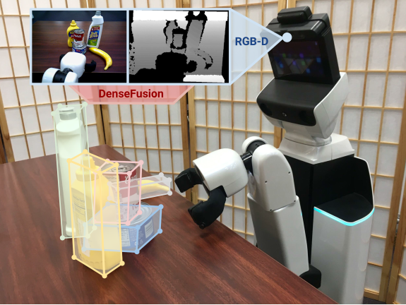
Motivation and Main Problem
why prior approaches didn’t already solve? & Key insights
Estimating Pose from RGB Images
Becomes unreliable in low-texture or low-resolution inputs.
Estimating Pose from Depth/Point Clouds
High computational cost.
Estimating Pose from RGB-D Data
Difficult to accurately estimate pose.
TEAM1
DenseFusion: 6D Object Pose Estimation by Iterative Dense Fusion

Slide 4
Problem Setting
Problem formulation, key definitions and notations
Problem formulation
Integrating color and depth information obtained by RGB cameras
The neural network architecture integrates iterative fine-tuning, eliminating dependence on post-processing ICP steps.
Key definitions
End-to-End: A system designed to work seamlessly from start to finish.
6D pose: includes three dimensional position coordinates (x, y, z) and three dimensional rotation angles (pitch, yaw, roll).
Dense Fusion: This approach integrates RGB and depth image data, utilizing a deep learning network to extract features and perform pose estimation.
TEAM1
DenseFusion: 6D Object Pose Estimation by Iterative Dense Fusion

Slide 5
Related Work & Limitations of Prior Work
Pose from RGB images
Classical method
“The moped framework: Object recognition and pose estimation for manipulation,” (A. Collet, M. Martinez, and S. S. Srinivasa,2011)
“Single image 3d object detection and pose estimation for grasping,”(M. Zhu, K. G. Derpanis, Y. Yang, S. Brahmbhatt, M.Zhang, C. Phillips, M. Lecce, and K. Daniilidis, 2014)
Learning to predict 2D key points
“Learning 6d object pose estimation using 3d object coordinates” (2014)
“6-dof object pose from semantic keypoints”(G. Pavlakos, X. Zhou, A. Chan, K. G. Derpanis, and K. Daniilidis, 2017)
“Real-Time Seamless Single Shot 6D Object Pose Prediction”(B. Tekin, S. N. Sinha, and P. Fua, 2018)
High computing costs and real-time challenges
It excels with rich textures and high-resolution inputs, but may become unreliable with low texture or low-resolution inputs.
TEAM1
5
DenseFusion: 6D Object Pose Estimation by Iterative Dense Fusion

Slide 6
Related Work & Limitations of Prior Work
Pose from depth/point cloud
Performing 6D pose estimation directly on 3D point cloud data
“Pointnet: Deep learning on point sets for 3d classification and segmentation,”(C. R. Qi, H. Su, K. Mo, and L. J. Guibas . 2016)
“Voxelnet: End-to-end learning for point cloud based 3d object detection,”.(Y. Zhou and O. Tuzel. 2017)
Estimating poses using voxelization input through 3D ConvNets
“Sliding shapes for 3d object detection in depth images”(S. Song and J. Xiao, 2014)
“Deep sliding shapes for amodal 3d object detection
in rgb-d images”(2016)
These methods are computationally expensive, for exampleeach frame takes nearly 20 seconds.
TEAM1
6
DenseFusion: 6D Object Pose Estimation by Iterative Dense Fusion

Slide 7
Related Work & Limitations of Prior Work
Setting poses from RGB-D data
PoseCNN estimates 6D pose directly from image data
“Posecnn:A convolutional neural network for 6d object pose estimation in cluttered scenes,” Y. Xiang, T. Schmidt, V. Narayanan, and D. Fox, 2017)
Extract 3D features from input RGB-D data, and perform grouping and hypothesis verification
“Learning 6d object pose estimationusing 3d object coordinates,”(E. Brachmann, A. Krull, F. Michel, S. Gumhold, J. Shotton, and C. Rother, 2014)
“Deep learning of local rgb-d patches for 3d object detection and 6d pose estimation,” (2016)
These methods typically rely on expensive post-processing steps to fully utilize 3D input.
These features may be hard coded or learned through optimizing alternative objects.
TEAM1
7
DenseFusion: 6D Object Pose Estimation by Iterative Dense Fusion

Slide 8
Proposed Approach
Innovation of the framework and Algorithm
Use the 2D information learned for this task in the embedding space to increase the information of each 3D point, and use this new color depth space to estimate the 6D pose.
Attitude estimation can improve accuracy through differentiable iterative fine-tuning modules. This module can be trained synchronously with the main architecture, with a short time consumption.
TEAM1
DenseFusion: 6D Object Pose Estimation by Iterative Dense Fusion
8

Slide 9
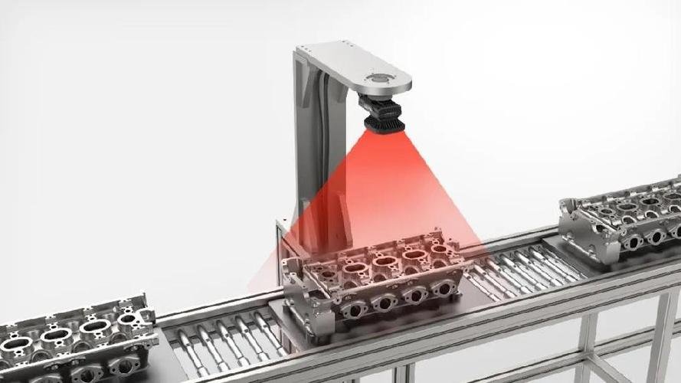
Theory
Model
Our goal is to estimate the 6D pose of a set of known we represent 6D poses as ho-mogeneous transformation matrix
p ∈ SE(3). In other words, a 6D pose is composed by a rotation R ∈ SO(3) and a translation t ∈ R3, p = [R|t].
TEAM1
DenseFusion: 6D Object Pose Estimation by Iterative Dense Fusion
Notes:
文中将夹取视为一个马尔可夫决策过程，给定机器人在时间t的通过视觉与触觉传感器获得状态信息st，和一个动作a，我们预测在应用该动作后，在t + 1时刻成功抓取的的概率。
训练的模型就是为了预测不同动作对应的夹取成功率。为了使夹取的成功率最大化，文章中通过随机采样潜在的动作a，用训练好的模型预测每个动作成功的概率，选取成功概率最大的动作。我们使用它来选择在执行动作后最大限度地提高把握成功的预期概率的动作

Slide 10
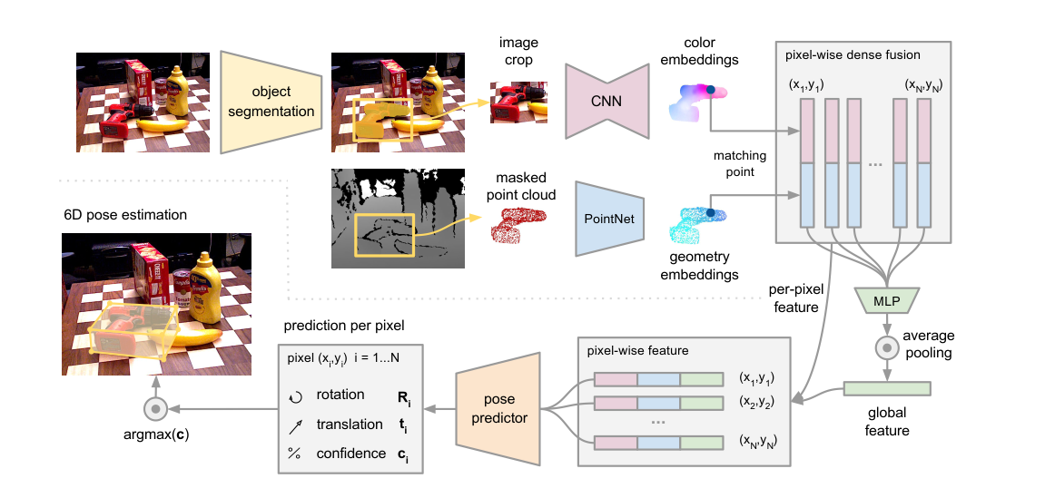
Theory
Overview of our 6D pose estimation model
TEAM1
DenseFusion: 6D Object Pose Estimation by Iterative Dense Fusion
Notes:
本文的抓取策略用到了马尔可夫决策过程(MDP)，用于选择最优的下一步抓取动作。马尔可夫决策过程是一种数学框架，用于描述具有随机性和时序性的决策问题。S是状态空间，描述所有可能状态的集合；A是动作空间，描述可以采取的所有动作的集合；P_{a}是转移概率，描述t时刻，在状态s下采取某个动作a后，在t+1时刻进入下一个状态s’的概率分布；R_{a}是奖励函数，描述在一个状态下采取某个动作，状态由s进入s’后获得的即时奖励。

Slide 11
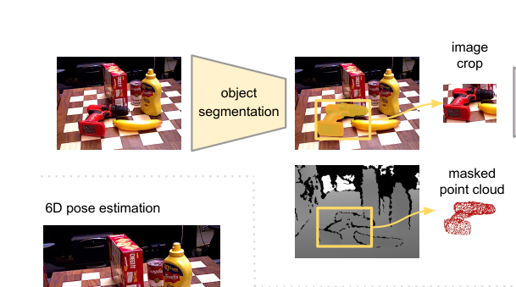
Theory
Semantic Segmentation
Our semantic segmentation network is an encoder-decoder architecture that takes an image as input and gener-ates an N +1-channelled semantic segmentation map. Each channel is a binary mask where active pixels depict objects of each of the N possible known classes.
TEAM1
DenseFusion: 6D Object Pose Estimation by Iterative Dense Fusion
Notes:
文中将夹取视为一个马尔可夫决策过程，给定机器人在时间t的通过视觉与触觉传感器获得状态信息st，和一个动作a，我们预测在应用该动作后，在t + 1时刻成功抓取的的概率。
训练的模型就是为了预测不同动作对应的夹取成功率。为了使夹取的成功率最大化，文章中通过随机采样潜在的动作a，用训练好的模型预测每个动作成功的概率，选取成功概率最大的动作。我们使用它来选择在执行动作后最大限度地提高把握成功的预期概率的动作

Slide 12
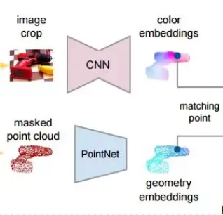
Theory
Dense Feature Extraction
Dense color image feature embedding:
The image embedding network is a CNN-based
encoder-decoder architecture that maps an image of size
H × W × 3 into a H × W × drgb embedding space.
Dense 3D point cloud feature embedding:
we ﬁrst convert the segmented depth pixels into a 3D point
cloud using the known camera intrinsics, and then use a
PointNet-like architecture to extract geometric features
TEAM1
DenseFusion: 6D Object Pose Estimation by Iterative Dense Fusion
Notes:
在验证模型时用到了k-fold 交叉验证的方法。
一般在验证某个模型在数据集上的表现时，我们需要衡量模型做出的预测与观测数据的匹配程度。最常用的测量方法是使用均方误差(MSE)。测试MSE让我们了解了一个模型在以前没有见过的数据上的表现。但是使用单一测试集存在一个缺点，有关测试集的信息会“泄漏”到模型中，评估指标就不是真实的反映模型泛化性能，导致在测试集上出现过度拟合的风险。

Slide 13
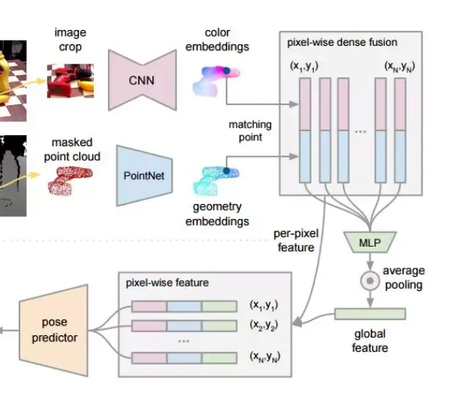
Theory
Pixel-wise Dense Fusion
We associate geometric features with corresponding image feature pixels to obtain dense fusion features.
These paired features are concatenated and fed into another network to generate a fixed-size global feature vector.
Dense fusion is obtained for each feature by combining dense fusion features with the global feature vector.
Each pixel-level feature is input into the final network to predict the 6D pose of the object.
TEAM1
DenseFusion: 6D Object Pose Estimation by Iterative Dense Fusion
Notes:
在验证模型时用到了k-fold 交叉验证的方法。
一般在验证某个模型在数据集上的表现时，我们需要衡量模型做出的预测与观测数据的匹配程度。最常用的测量方法是使用均方误差(MSE)。测试MSE让我们了解了一个模型在以前没有见过的数据上的表现。但是使用单一测试集存在一个缺点，有关测试集的信息会“泄漏”到模型中，评估指标就不是真实的反映模型泛化性能，导致在测试集上出现过度拟合的风险。

Slide 14
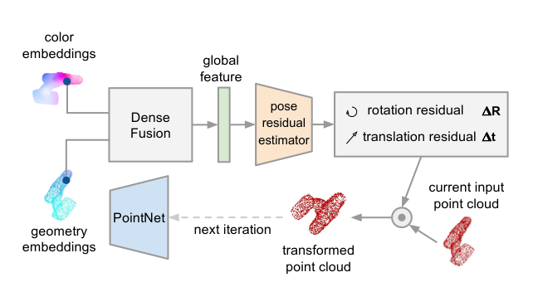
Theory
6D Object Pose Estimation
minimize for the
prediction per dense-pixel (asymmetric):
minimize for the prediction per dense-pixel(symmetric):
minimize for the prediction:
TEAM1
DenseFusion: 6D Object Pose Estimation by Iterative Dense Fusion

Slide 15
Theory
Iterative Reﬁnement
We employ a dedicated pose residual estimation network to refine the pose estimation from the main network. At each iteration, we fuse the image features and point cloud geometric features to obtain a more precise pose estimation. The final pose estimation is composed of the results obtained from multiple iterations.
TEAM1
DenseFusion: 6D Object Pose Estimation by Iterative Dense Fusion
Notes:
在验证模型时用到了k-fold 交叉验证的方法。
一般在验证某个模型在数据集上的表现时，我们需要衡量模型做出的预测与观测数据的匹配程度。最常用的测量方法是使用均方误差(MSE)。测试MSE让我们了解了一个模型在以前没有见过的数据上的表现。但是使用单一测试集存在一个缺点，有关测试集的信息会“泄漏”到模型中，评估指标就不是真实的反映模型泛化性能，导致在测试集上出现过度拟合的风险。

Slide 16
Experiments
In order to verify the more accurate effect and real-time performance of the densefusion model, the author set up a series of experiments to verify the performance and effect of the model
TEAM1
DenseFusion: 6D Object Pose Estimation by Iterative Dense Fusion

Slide 17
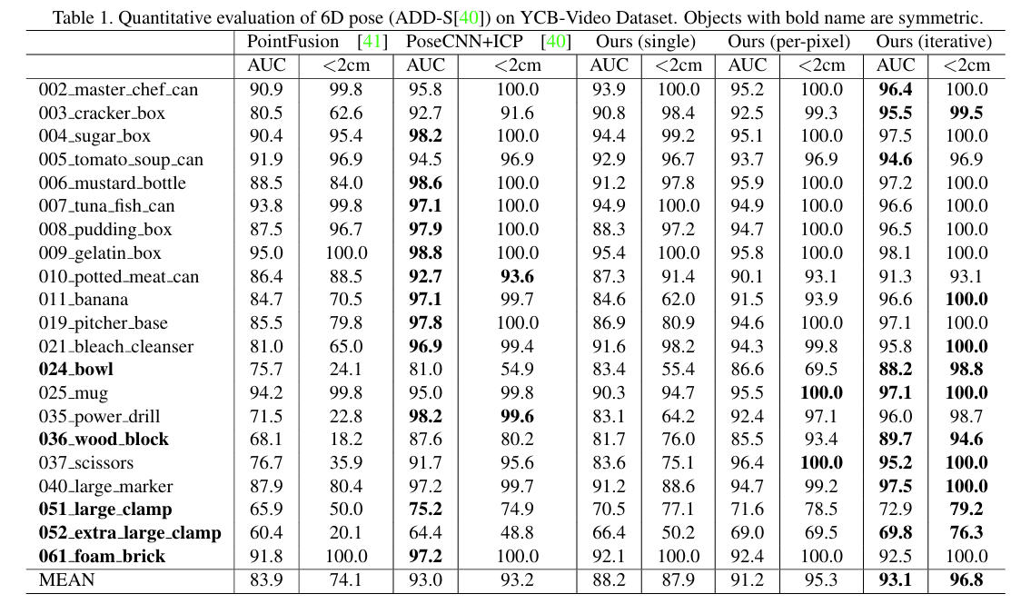
Datasets and Evaluation Metrics
YCB-Video Dataset: This dataset comprises
RGB-D images from various videos, with
clearly annotated 6D poses of objects
within these images. It is used to assess the
performance of DenseFusion in handling
everyday objects.
LineMOD Dataset: This is a standard dataset widely used for object pose estimation, featuring images of objects with low texture and precise pose annotations.
TEAM1
DenseFusion: 6D Object Pose Estimation by Iterative Dense Fusion

Slide 18
Comparison with Existing Technologies
DenseFusion's performance is compared with other advanced technologies such as PoseCNN and PointFusion, analyzing accuracy and real-time capabilities on standard datasets.
Occlusion Handling Capability: The model's ability to handle partially occluded objects is specially analyzed by comparing the pose estimation accuracy when parts of objects are visible.
Processing Speed: The time DenseFusion takes to estimate the pose of a single object is measured, demonstrating its suitability for real-time applications.
Impact of Iterative Refinement: The gradual improvement in pose estimation accuracy through iterative refinement steps is observed, validating the contribution of this process to overall performance.
TEAM1
DenseFusion: 6D Object Pose Estimation by Iterative Dense Fusion

Slide 19
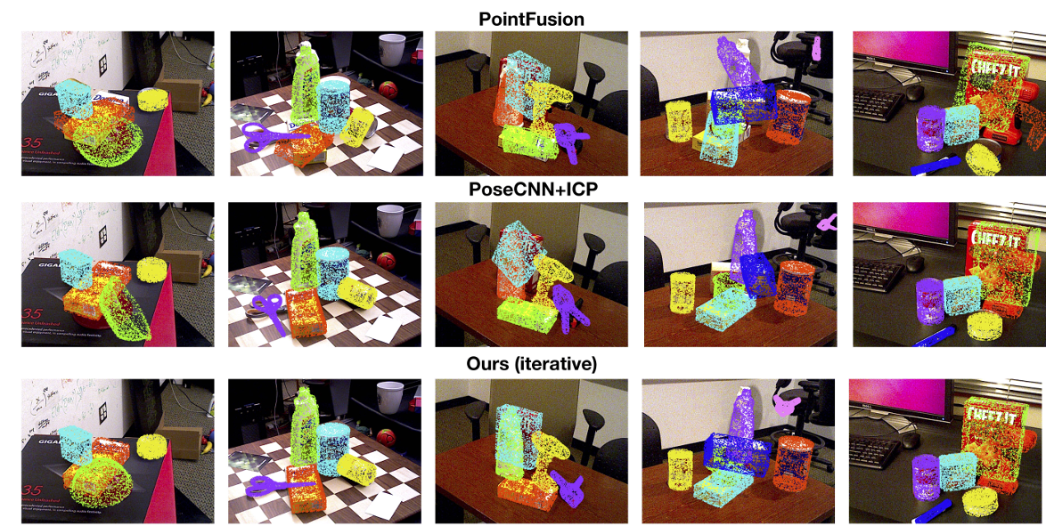
Comparison with Existing Technologies
【DenseFusion: 6D Object Pose Estimation by Iterative Dense Fusion】 https://www.bilibili.com/video/BV1fg4y187um/?share_source=copy_web&vd_source=3fbda0f34adfb8a51c1f2203d2e770aa
TEAM1

Slide 20
Real-World Application Testing
Robotic Grasping Experiment:
Experimental Setup: DenseFusion is deployed on a real robotic platform, where the robot is used to locate and grasp objects.
Task Execution: The robot attempts to grasp objects placed in various positions and orientations, recording the success rate to verify the accuracy and practicality of the pose estimation.
Environmental Adaptability: DenseFusion is tested under different background and lighting conditions to assess its robustness across diverse environments.
TEAM1
DenseFusion: 6D Object Pose Estimation by Iterative Dense Fusion

Slide 21
Thanks！
TEAM1
DenseFusion: 6D Object Pose Estimation by Iterative Dense Fusion

