Slide 1
Overconstrained Quadruped Locomotion using Reinforcement Learning
Guojing Huang: 12111820 | Jinda Dong: 12111829
Junwei Lu: 12212928| Xinyan Ju: 12111142
Zhou Chen: 12111812| Shengyang Ming: 12111717

Slide 2
Proposed Project Title Summary
What we want to study is to train a quadrupedal robot through (deep) reinforcement learning to pass all kinds of obstacles on its own, such as "high hurdles", "slopes", "steps", "double wooden bridges", and "stumps". This problem is interesting because quadrupedal robots are becoming more and more popular in scientific research and commercialization, and reinforcement learning is a learning control algorithm that has been widely used by research institutes and commercial companies in recent years, so we would like to combine both of them for this course project.
We will purposely read relevant papers according to the existing situation and progress, such as, model and algorithm construction, performance comparison and optimization, and sim-to-real success deployment.
We have now collected some preliminary data, one is the robot ontology configuration, firstly, we have collected the stl model of the robot as well as the available urdf and usd files for describing and simulating the robot; secondly, we have chosen the Cybergear, as the driver of the quadruped robot, and we have also obtained the key parameters of the motor based on the instruction manual; then we have chosen to train the quadruped robot in two kinds of simulation environments for training, one is flat ground and the other is self-built field; lastly, the camera, if we need to train on the self-built field, we need to add a camera to the quadruped robot to detect obstacles. Meanwhile, we will obtain some data and support that may be needed in the future by looking up papers, open source materials, product manuals, etc.
We will use “Issac Sim” developed by NVIDIA as software platform, and the orbit framework is used for training. The training method is rsl_rl, which is a fast and simple implementation of RL algorithm, designed to run fully on GPU. We will validate its feasibility at first and then modify the parameters of learning and control strategy to achieve better performances.
As for results, we currently choose the relatively easy-to-obtain parameters of velocity, COT, reward, and joint torque as the technical indexes for evaluating the training results, which will eventually be analyzed by figures or tables.

Slide 3
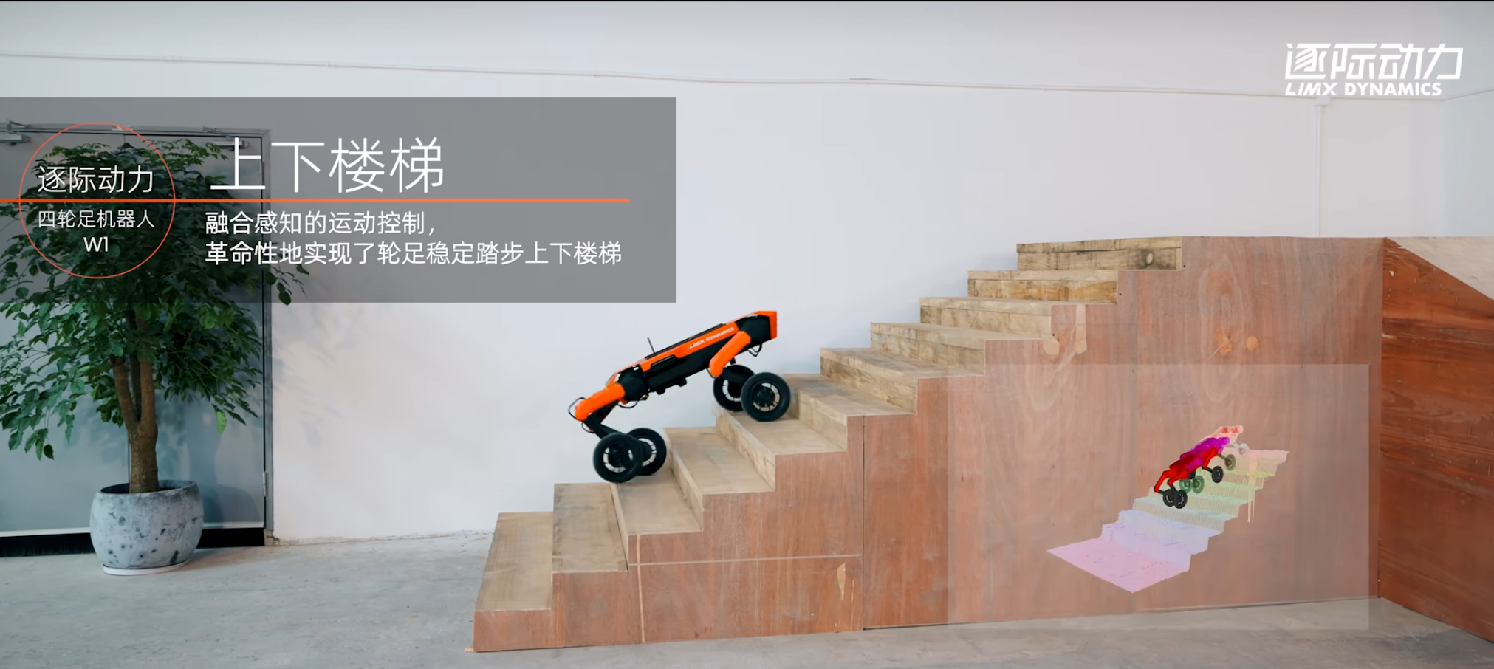
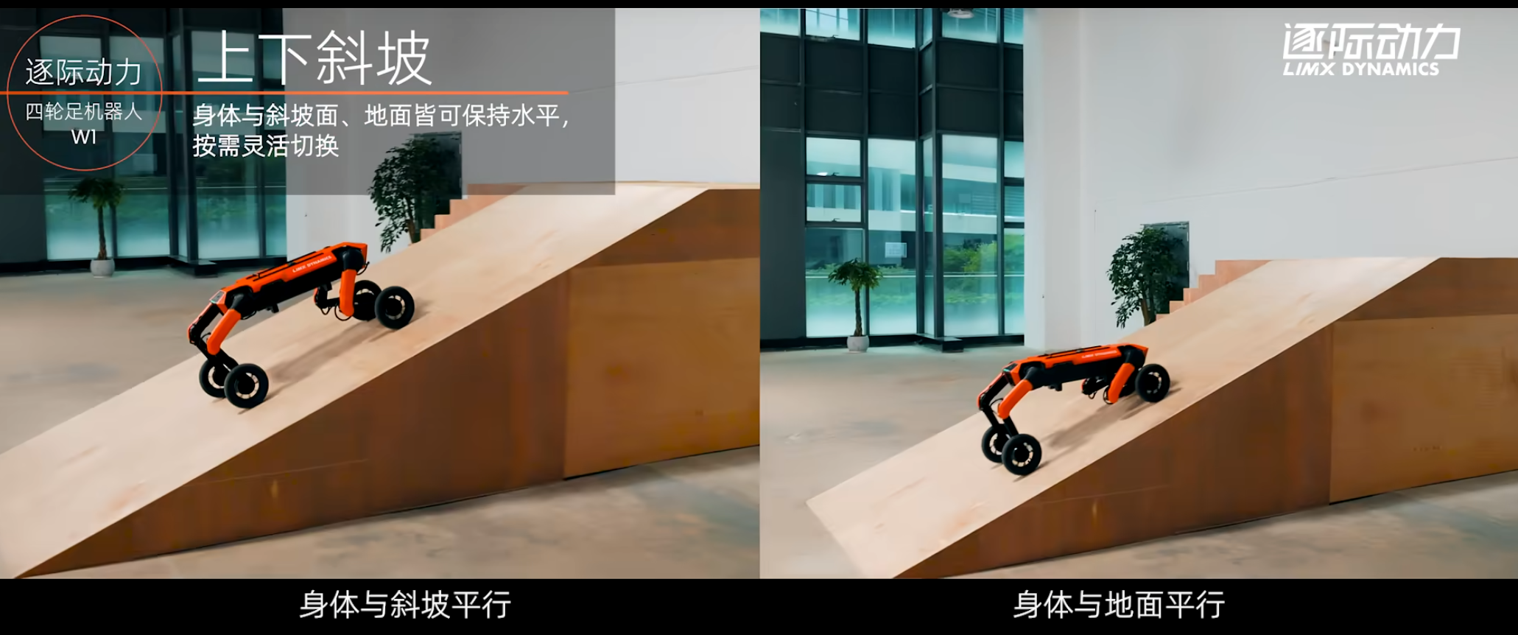
What is the problem that you will be investigating?
Why is it interesting?
What we want to study is to train a quadrupedal robot through (deep) reinforcement learning to pass all kinds of obstacles on its own, such as "high hurdles", "slopes", "steps", "double wooden bridges", and "stumps". This problem is interesting because quadrupedal robots are becoming more and more popular in scientific research and commercialization, and reinforcement learning is a learning control algorithm that has been widely used by research institutes and commercial companies in recent years, so we would like to combine both of them for this course project.

Slide 4
What reading will you examine?
We will purposely read relevant papers according to the existing situation and progress, such as, model and algorithm construction, performance comparison and optimization, and sim-to-real success deployment.
X. B. Peng, G. Berseth, M. Van de Panne, Terrain-adaptive locomotion skills using deep reinforcement learning, ACM Transactions on Graphics (TOG) 1–12 (2016).
Y. Yang, K. Caluwaerts, A. Iscen, T. Zhang, J. Tan, V. Sindhwani, Data efficient reinforcement learning for legged robots, Conference on Robot Learning, 1–10 (PMLR, 2020)
Takahiro Miki et al. ,Learning robust perceptive locomotion for quadrupedal robots in the wild.Sci. Robot.7,eabk2822(2022).
V. Tsounis, M. Alge, J. Lee, F. Farshidian, M. Hutter, Deepgait: Planning and control of quadrupedal gaits using deep reinforcement learning, IEEE Robotics and Automation Letters 3699–3706 (2020).
S. Gangapurwala, M. Geisert, R. Orsolino, M. Fallon, I. Havoutis, RLOC: Terrain-aware legged locomotion using reinforcement learning and optimal control, arXiv preprint arXiv:2012.03094 (2020).

Slide 5
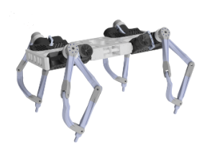
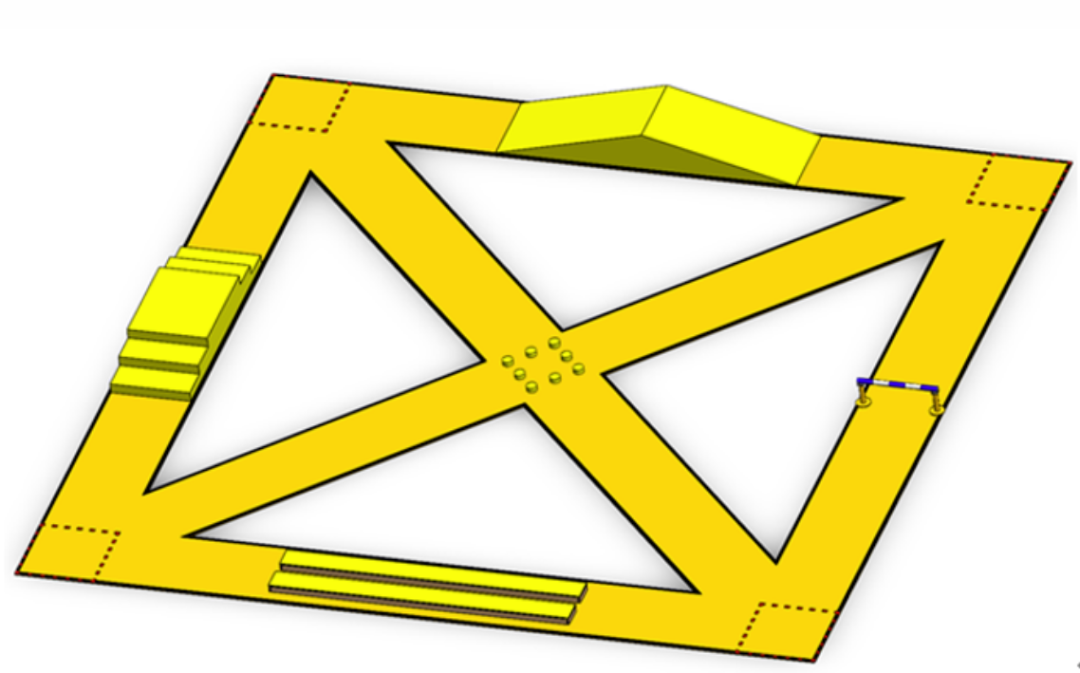
What data will you use?
Overconstrained Quadruped(Robot), Cybergear(Motor),Field(Environment)
We have now collected some preliminary data, one is the robot ontology configuration, firstly, we have collected the stl model of the robot as well as the available urdf and usd files for describing and simulating the robot; secondly, we have chosen the Cybergear, as the driver of the quadruped robot, and we have also obtained the key parameters of the motor based on the instruction manual; then we have chosen to train the quadruped robot in two kinds of simulation environments for training, one is flat ground and the other is self-built field; lastly, the camera, if we need to train on the self-built field, we need to add a camera to the quadruped robot to detect obstacles. Meanwhile, we will obtain some data and support that may be needed in the future by looking up papers, open source materials, product manuals, etc.

Slide 6
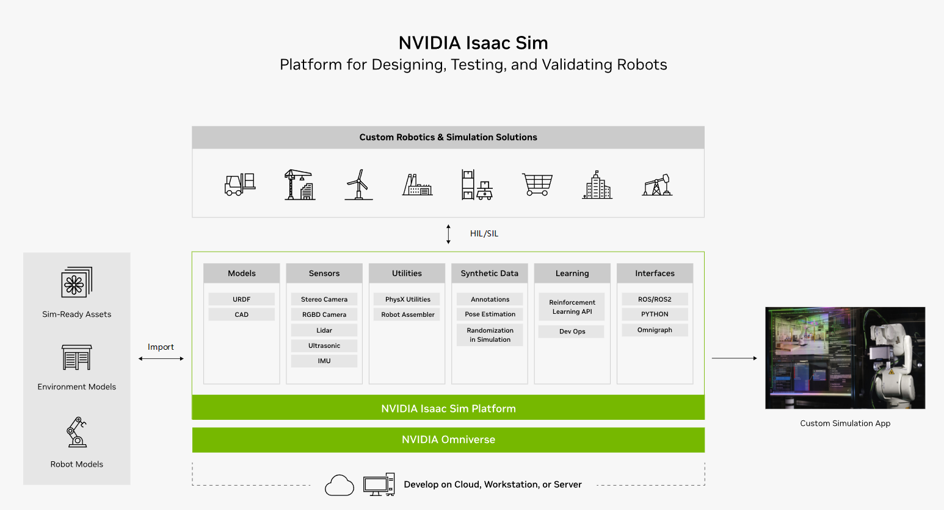
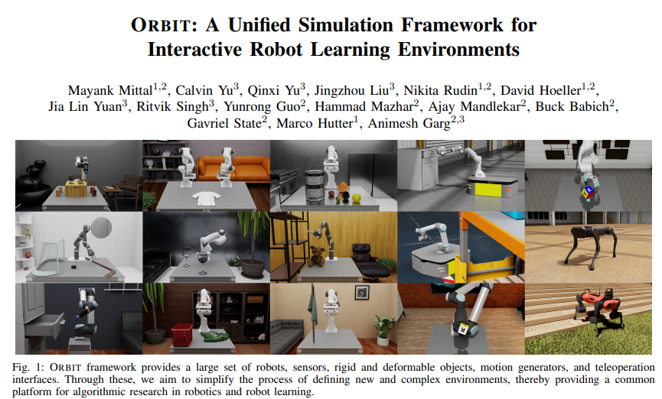
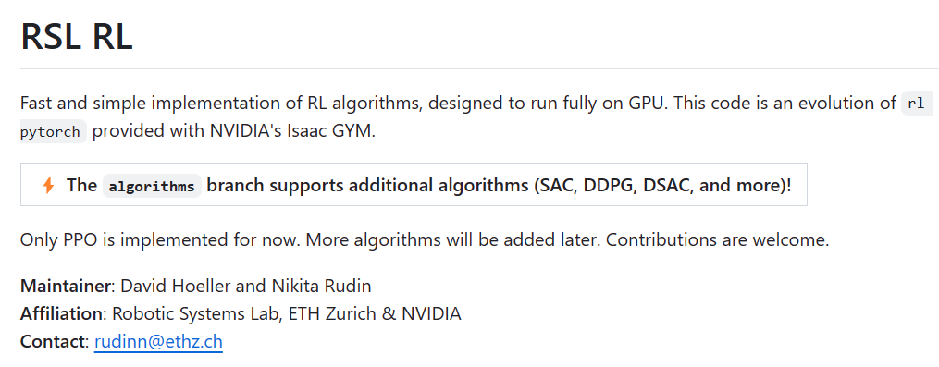
What method or algorithm are you proposing?
Issac Sim + ORBIT + RSL_RL
We will use “Issac Sim” developed by NVIDIA as software platform, and the orbit framework is used for training. The training method is rsl_rl, which is a fast and simple implementation of RL algorithm, designed to run fully on GPU. We will validate its feasibility at first and then modify the parameters of learning and control strategy to achieve better performances.
https://developer.nvidia.com/isaac-sim https://github.com/leggedrobotics/rsl_rl https://github.com/leggedrobotics/rsl_rl

Slide 7
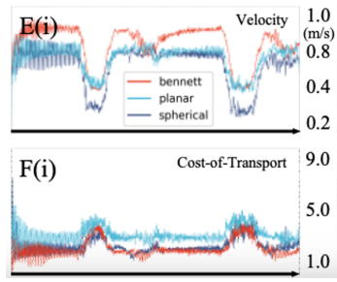
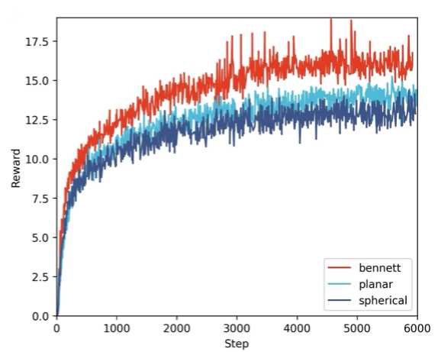
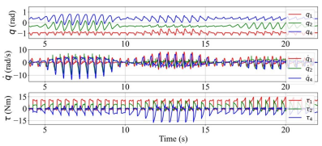
How will you evaluate your results?
Figures + Tables
As for results, we currently choose the relatively easy-to-obtain parameters of velocity, COT, reward, and joint torque as the technical indexes for evaluating the training results, which will eventually be analyzed by figures or tables.

Slide 8
Overconstrained Quadruped Locomotion using Reinforcement Learning
Guojing Huang
Robotics Engineering
Chaoyang Song
12111820@mail.sustech.edu.cn

