Slide 1
CasaBot
Home Assistance: The Fusion of AI and Robotics for Daily Tasks
Daniel Tan Sioa Hen: 12111127 | Ng Wooi Cheng: 12111128
汪俊扬: 12111028 | 周靖东: 12111026
毛新科:11910412 | 邓皓文: 12110510 | 季亦冰12110501
Group 4
2024.3.24

Slide 2
Proposed Project Title Summary
The project aims to develop a collaborative robot arm for home automation, leveraging natural language interaction to enhance accessibility and autonomy. Integrating robotics, AI, computer vision, and natural language processing, the initiative seeks to advance human-robot interaction, enabling real-time task execution beyond traditional automation boundaries. With a focus on aiding people with disabilities, the project drives technological innovation in AI and robotics, pushing the boundaries of machine learning to comprehend complex instructions and environmental cues. Through readings covering object recognition and manipulation techniques, including studies by Bulun, Tremblay et al., Mousavian et al., and Breyer et al., alongside resources on YOLOv8 and GPT's role in robotics, the project gains insights crucial for its development. Utilizing datasets such as LLM prompt dataset, COCO, FAT, and YCB-Video, along with simulation tools like Robosuite and Gazebo, and deep learning frameworks like PyTorch, the project focuses on object recognition using models like Faster R-CNN, SSD, and YOLOv8. Advancements in object pose detection and grasping involve deep learning methods trained on synthetic data. Deep Object Pose Estimation uses a mix of domain randomized and photorealistic data to train a neural network for accurate 6-DoF pose estimation from single RGB images. 6-DoF GraspNet employs variational autoencoders to generate and refine grasp poses using 3D point cloud data. Volumetric Grasping Network utilizes a 3D CNN to predict 6-DoF grasps from scene information represented as a Truncated Signed Distance Function (TSDF), providing grasp quality, orientation, and width predictions at the voxel level. Integration of user APIs with ROS enables seamless interaction, facilitating tasks such as fine-tuning pre-trained models and executing actions based on commands. Natural language interaction is facilitated through text-to-speech and speech-to-text functionalities, with temperature parameter adjustment influencing output randomness during text generation. Evaluation of results encompasses simulator experiments like Cleanup and Sort Tasks, categorized by general categories, object attributes, and functions, alongside interaction experiments with volunteers to assess performance in terms of response time, task accuracy, command understanding, completion rate, and user satisfaction, ultimately pioneering the future of home automation and human-robot interaction.

Slide 3
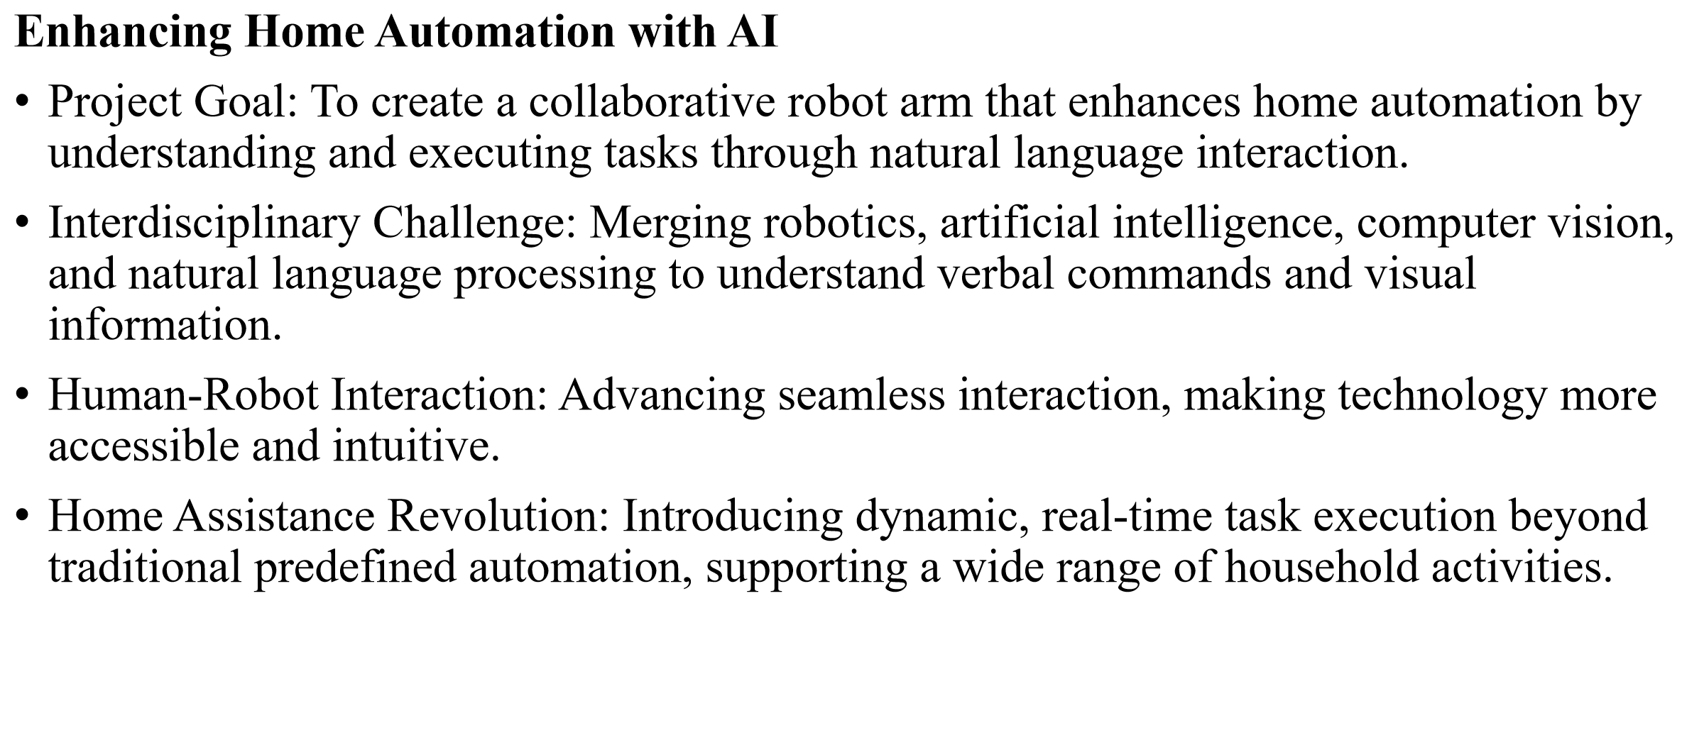
What is the problem that you will be investigating?

Slide 4
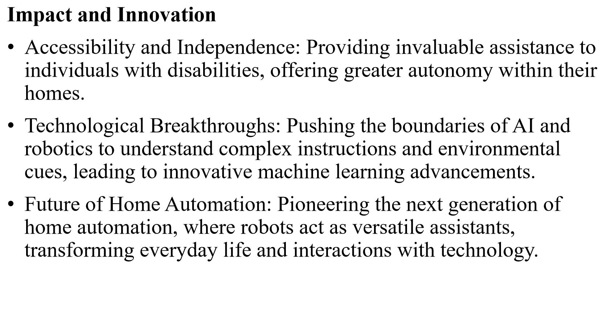
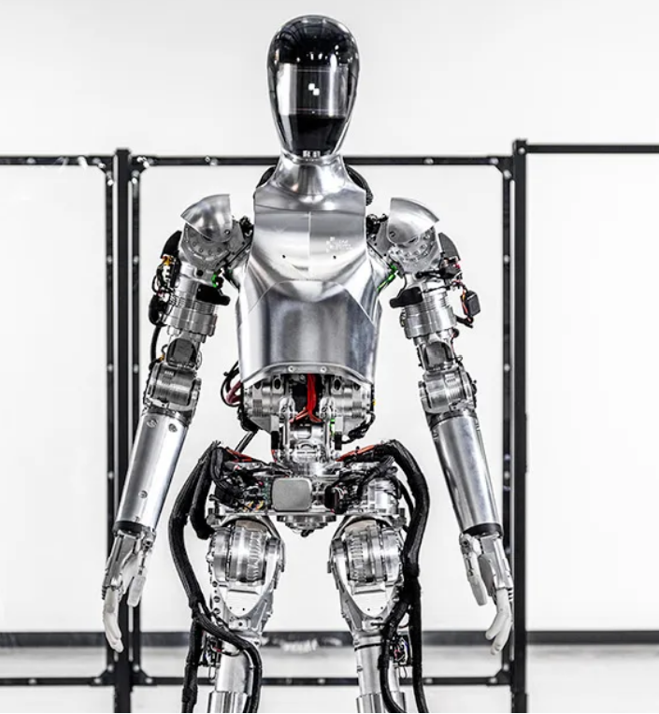
What is the problem that you will be investigating?

Slide 5
What reading will you examine?
Object Recognition:
Bulun, S. (2023). Object Recognition and Tracking of Bolts: A Comparative Analysis of CNN Models and Computer Vision Techniques : A Comparison of CNN Models and Tracking Algorithms (Dissertation). Retrieved from https://urn.kb.se/resolve?urn=urn:nbn:se:kth:diva-337061
https://learnopencv.com/ultralytics-yolov8/
Object Pose Detection and Grasping:
Tremblay, J., To, T., Sundaralingam, B., Xiang, Y., Fox, D., & Birchfield, S. (2018). Deep object pose estimation for semantic robotic grasping of household objects. arXiv preprint arXiv:1809.10790.
Mousavian, A., Eppner, C., & Fox, D. (2019). 6-dof graspnet: Variational grasp generation for object manipulation. In Proceedings of the IEEE/CVF international conference on computer vision (pp. 2901-2910).
Breyer, M., Chung, J. J., Ott, L., Siegwart, R., & Nieto, J. (2021, October). Volumetric grasping network: Real-time 6 dof grasp detection in clutter. In Conference on Robot Learning (pp. 1602-1611). PMLR.
GPT-part:
https://www.microsoft.com/enus/research/uploads/prod/2023/02/ChatGPT___Robotics.pdf
https://tidybot.cs.princeton.edu/

Slide 6
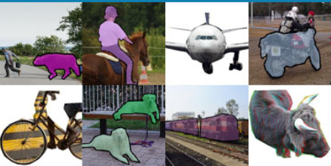
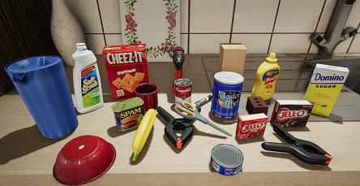
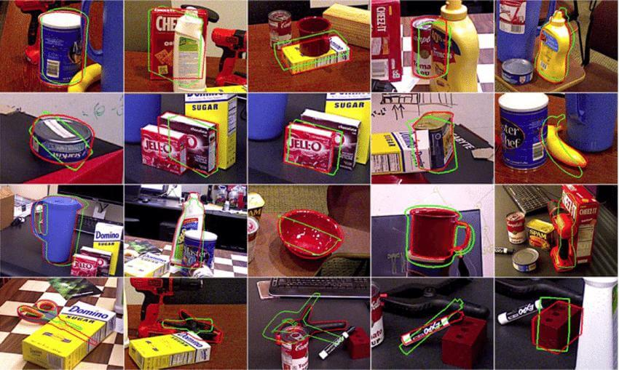
What data will you use?
LLM prompt dataset from TidyBot
Common Objects in Context (COCO)
Falling Things(FAT),from NVIDIA
YCB-Video dataset

Slide 8
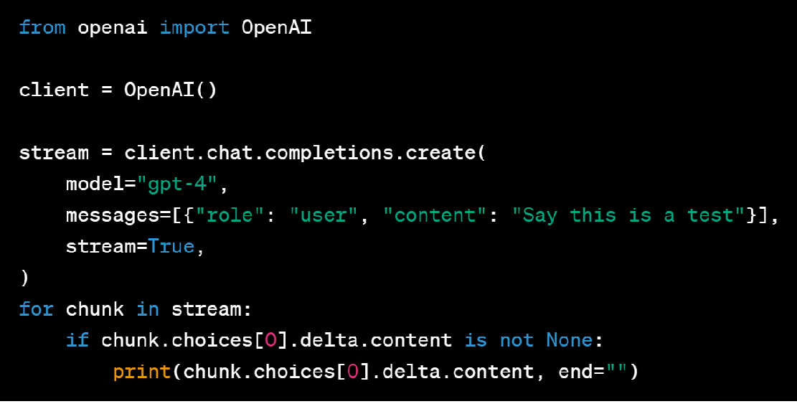
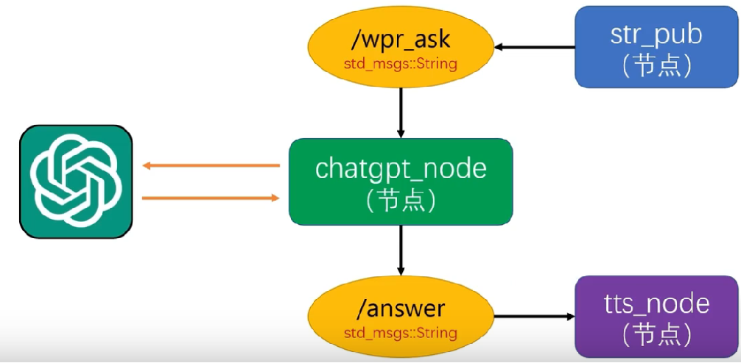
What method or algorithm are you proposing?
https://github.com/play-with-chatgpt/wpr_chatgpt

Slide 9
What method or algorithm are you proposing?
https://github.com/play-with-chatgpt/wpr_chatgpt

Slide 10
What method or algorithm are you proposing?
https://github.com/play-with-chatgpt/wpr_chatgpt

Slide 11
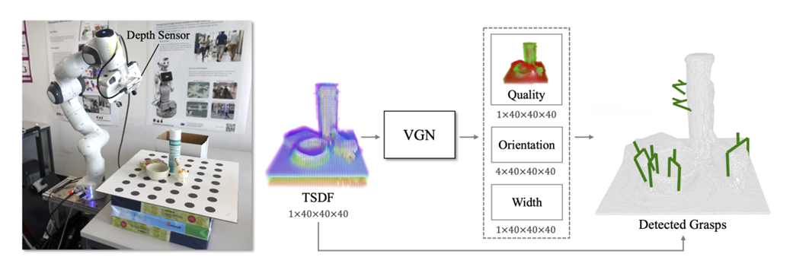
What method or algorithm are you proposing?
Object Pose Detection and Grasping：
Deep Object Pose Estimation
Based on synthetic data, using a combination of domain randomized and photorealistic synthetic data to train a deep neural network for 6-DoF pose estimation of known objects from a single RGB image.
6-DoF GraspNet
Employing a method based on variational autoencoders to generate grasp poses. This approach sampling a set of grasp poses using variational autoencoders and utilizes a grasp evaluation model to assess and refine these sampled grasps, based on 3D point clouds observed by depth cameras.
Volumetric Grasping Network
Designing and training a 3D CNN to predicts 6 DOF grasps from 3D scene information. The network takes a Truncated Signed Distance Function (TSDF) representation of the scene as input and outputs a volume of the same spatial resolution. Each cell within this volume contains the predicted quality, orientation, and width of a grasp executed at the center of the voxel.

Slide 12
What method or algorithm are you proposing?
Object Pose Detection and Grasping：
 | Pros | Cons
Deep Object Pose Estimation (DOPE) | Simple input (RGB image) Accurate estimation of the 6D pose of objects Various scenes | Performance might degrade in cluttered or complex scenes May not directly provide grasp planning
6-DoF GraspNet | Providing precise 6-DoF grasp poses Utilizes synthetic data for training Can handle cluttered scenes and unknown objects Trained in simulation and can be directly applied in the real world | No direct object pose estimation Noise sensitive Data dependent
Volumetric Grasping Network (VGN) | real-time 6 DOF grasp detection high success rates in cluttered scenes without explicit collision checking | Relatively complex architecture and training process (TSDF) Data dependent

Slide 13
What method or algorithm are you proposing?
https://github.com/play-with-chatgpt/wpr_chatgpt

Slide 14
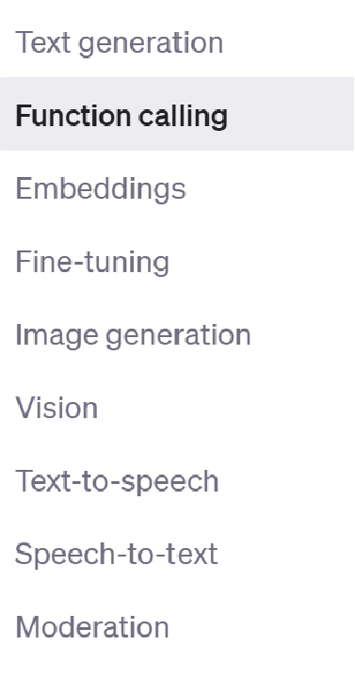
What method or algorithm are you proposing?
1.Fine-tuning: Customizes a pre-trained model to better suit specific tasks by training on a specialized dataset. CasaBot could use fine-tuning to improve its understanding of household-specific language and tasks and reply us in a specific format.
2.Function Calling: Executes specific tasks or actions in response to commands. For CasaBot, this allows it to interpret commands and call the appropriate routines for actions like grasping objects.
3. Vision: Refers to the machine's ability to understand and interpret visual data. For CasaBot, computer vision is essential for identifying objects and navigating the home environment. 4. Text-to-Speech &Speech-to-Text: Interactions.
5.Temperature:A parameter used during text generation that influences the randomness of the output.

Slide 15
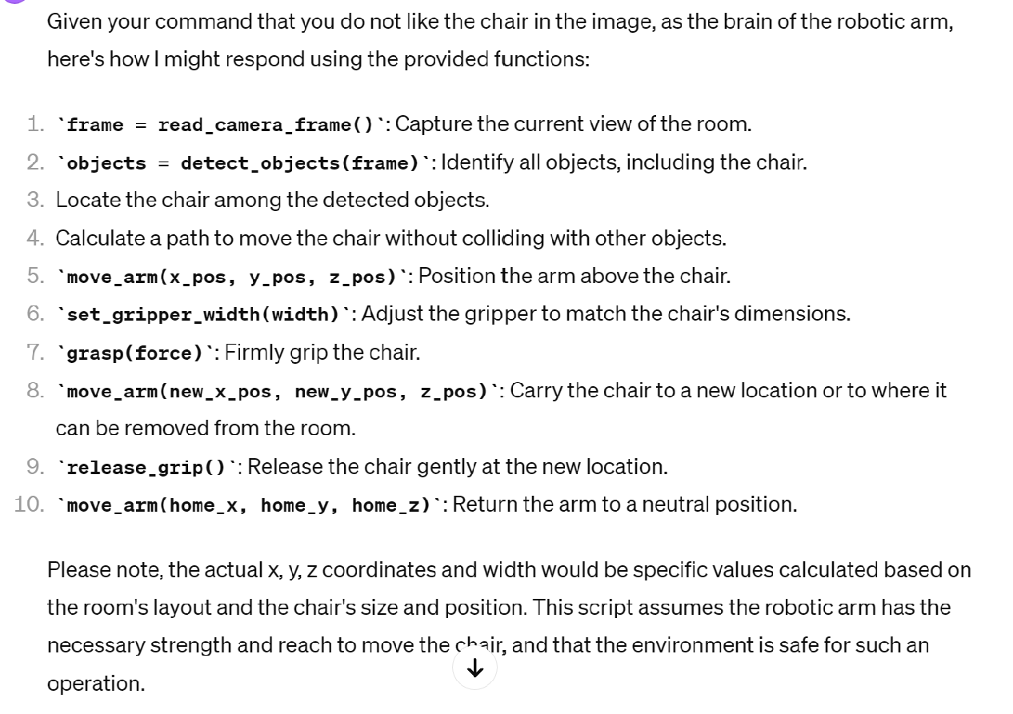
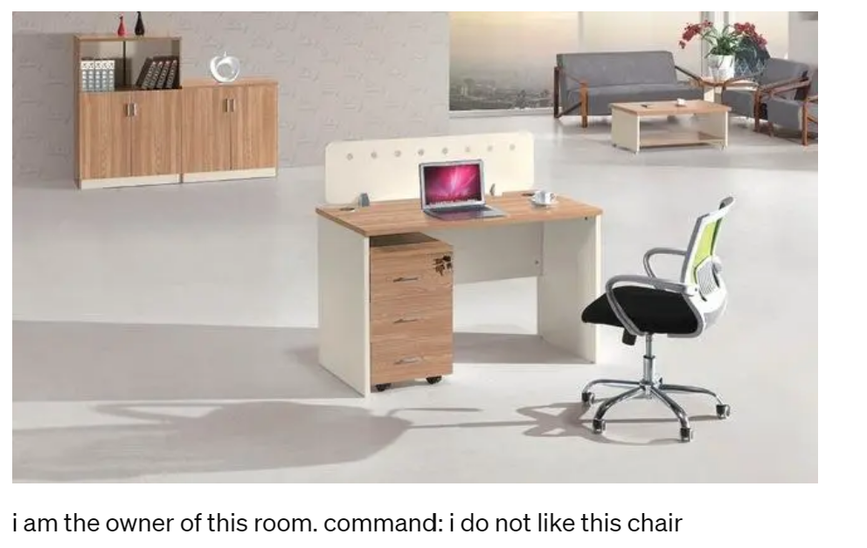
What method or algorithm are you proposing?

Slide 16
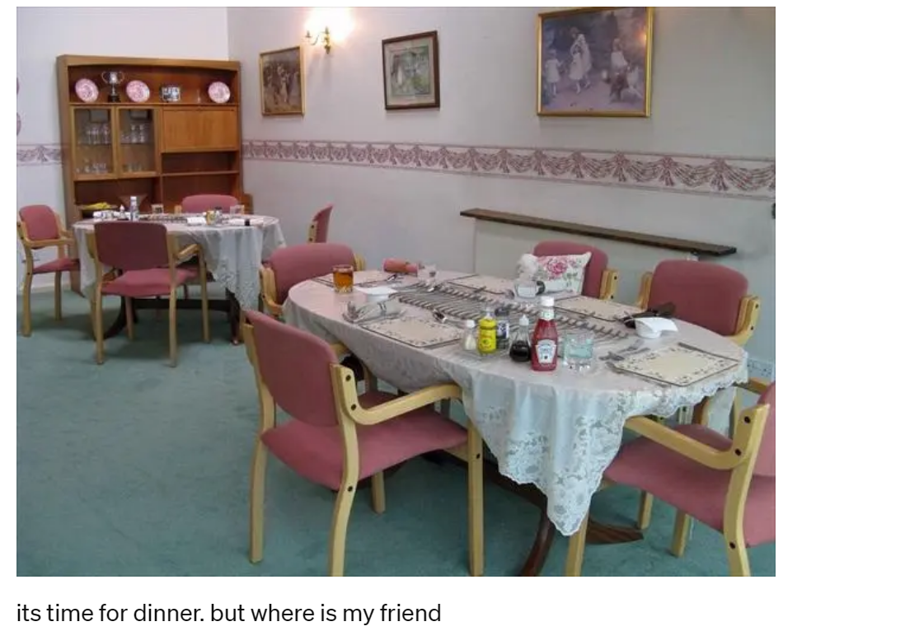
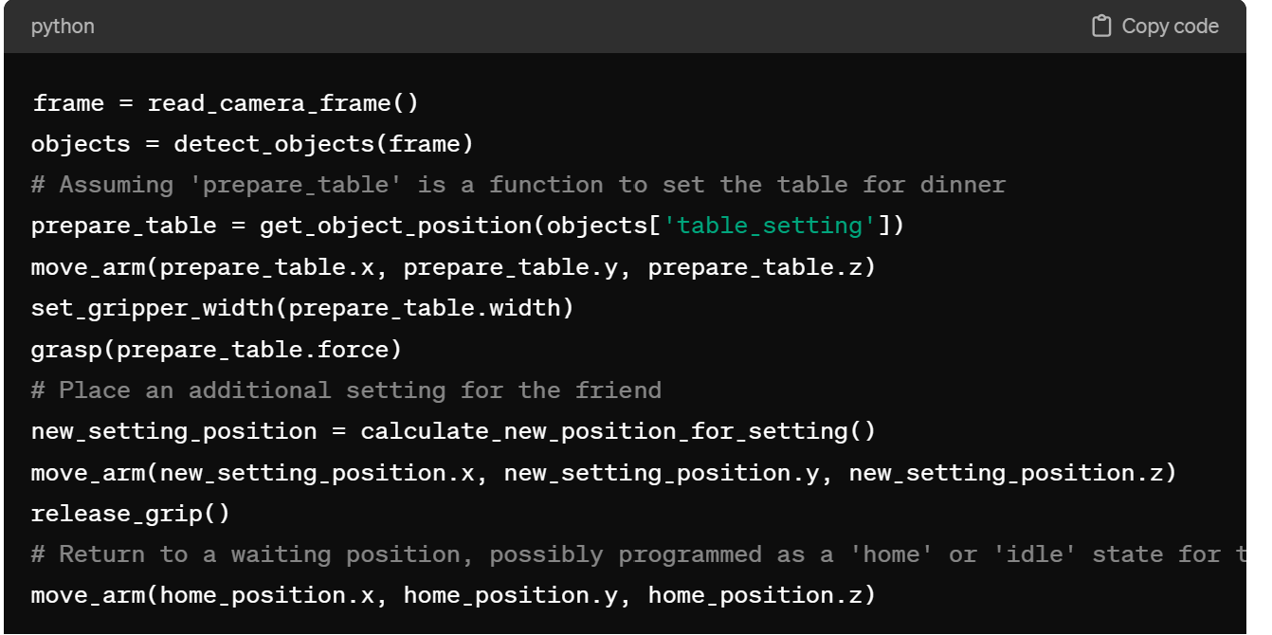
What method or algorithm are you proposing?

Slide 17
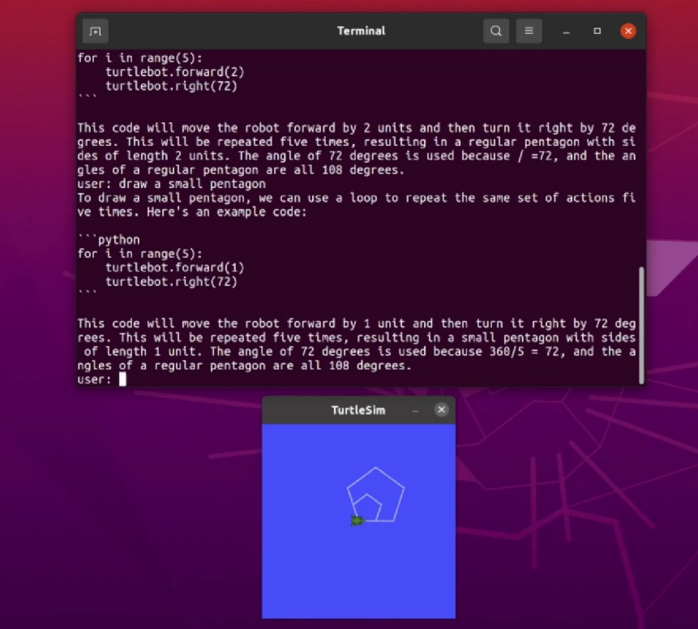
What method or algorithm are you proposing?
Related Works
TidyBot
https://rdcu.be/dChXj
https://github.com/chinaheyu/chatgpt_ros

Slide 18
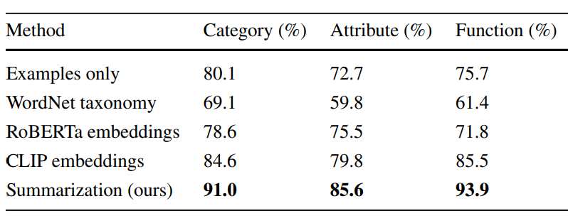
How will you evaluate your results?
Experiment in Simulator
Cleanup Task
Two different scenarios, each with its own set of 10 objects, 2-3 receptacles.
Sort Task:
•based on general categories (e.g.,put clothes here and toys there) •based on object attributes (e.g., put plastic items here and metal items there) •based on function (e.g., put winter clothes here and summer clothes there)

Slide 19
How will you evaluate your results?
Interaction Experiment
Invite volunteers to test our CasaBot and evaluate it from following aspects:
Response Time: How quickly does CasaBot acknowledge and begin executing a command?
Task Accuracy: How accurately does CasaBot perform the tasks given in the commands?
Command Understanding: Does CasaBot correctly understand the details of the command?
Completion Rate: What percentage of tasks is CasaBot able to complete successfully?
User Satisfaction: How satisfied are users with the interactions?

Slide 20
SUSTech Design + Learning Lab PowerPoint Template
Name
Affiliation
Supervisor
Contact

